Slide 1
INDOOR TRACKING:
EQUIPMENT AT
CHOA
Brian Weber
Alex Sabulski
Zach Davis

Slide 2
INTRODUCTION
Indoor tracking of equipment within the hospital
1 floor
1 wing of the hospital
Provide indicators for required maintenance
Include a way to reset maintenance alerts
View tracked devices within an iOS application
- 02 -

Slide 3
SPECIFICATIONS
Localization with minimal error
3 meters max; as small as possible
Tracking over the entire hospital wing (100 m x 100 m area)
The system must be portable for use with new equipment
Maintenance requests should be automated
Localization data must be provided visually to the user

Slide 4
DESIGN
Implementing the Pozyx ultra-wideband communication system
Software:
iOS application, Google Cloud Platform, MySQL DB
Hardware:
Raspberry Pi Zero W
Pozyx shield tag
4 Pozyx anchors
Button to reset the maintenance timer
LEDs
Rechargeable USB power supply
Description:
Raspberry Pi receives 2-D coordinates in mm accuracy using Pozyx positioning shield. Shield ID is uploaded to MySQL database with coordinates and other useful information
Red LED indicates that maintenance is needed; Green LED indicates use
iOS application receives database information from Google cloud and shows location for equipment on hosptial map
With usage info and maintenance time

Slide 5
IMPLEMENTATION: OVERALL
Setup hardware in our test environment
Must test in the hospital
Implemented the Pozyx Python library with our MySQL database
Need to finish visualization within the iOS app
We know the general design of our tracking device
Need to figure out dimensions & design an enclosure
We’ve tested our system in a room
Need to expand to a bigger area after finishing our implementation
Setup Hardware
Software Design
75%
85%
80%
Enclosure & Overall
System Design
50%
Testing
5

Slide 6
IMPLEMENTATION: iOS APPLICATION
Our Clients have specifically asked for an iOS application that Doctors, Nurses, and other hospital staff would all have access to.
The app is to have a map of the hospital wing that equipment we will be tracking is kept.
Pins marking the location of all tracked equipment relative to the map of the wing.
Detailed information about the specific equipment such as
Use State
Floor
Maintenance Record/Tracker
Rented/Owned
In order to do these things we will need a MySQL DB that will receive data from the tracking IC chips as well as cloud storage for that DB so that this can be pulled from a device over a network to be used by the app.

Slide 7
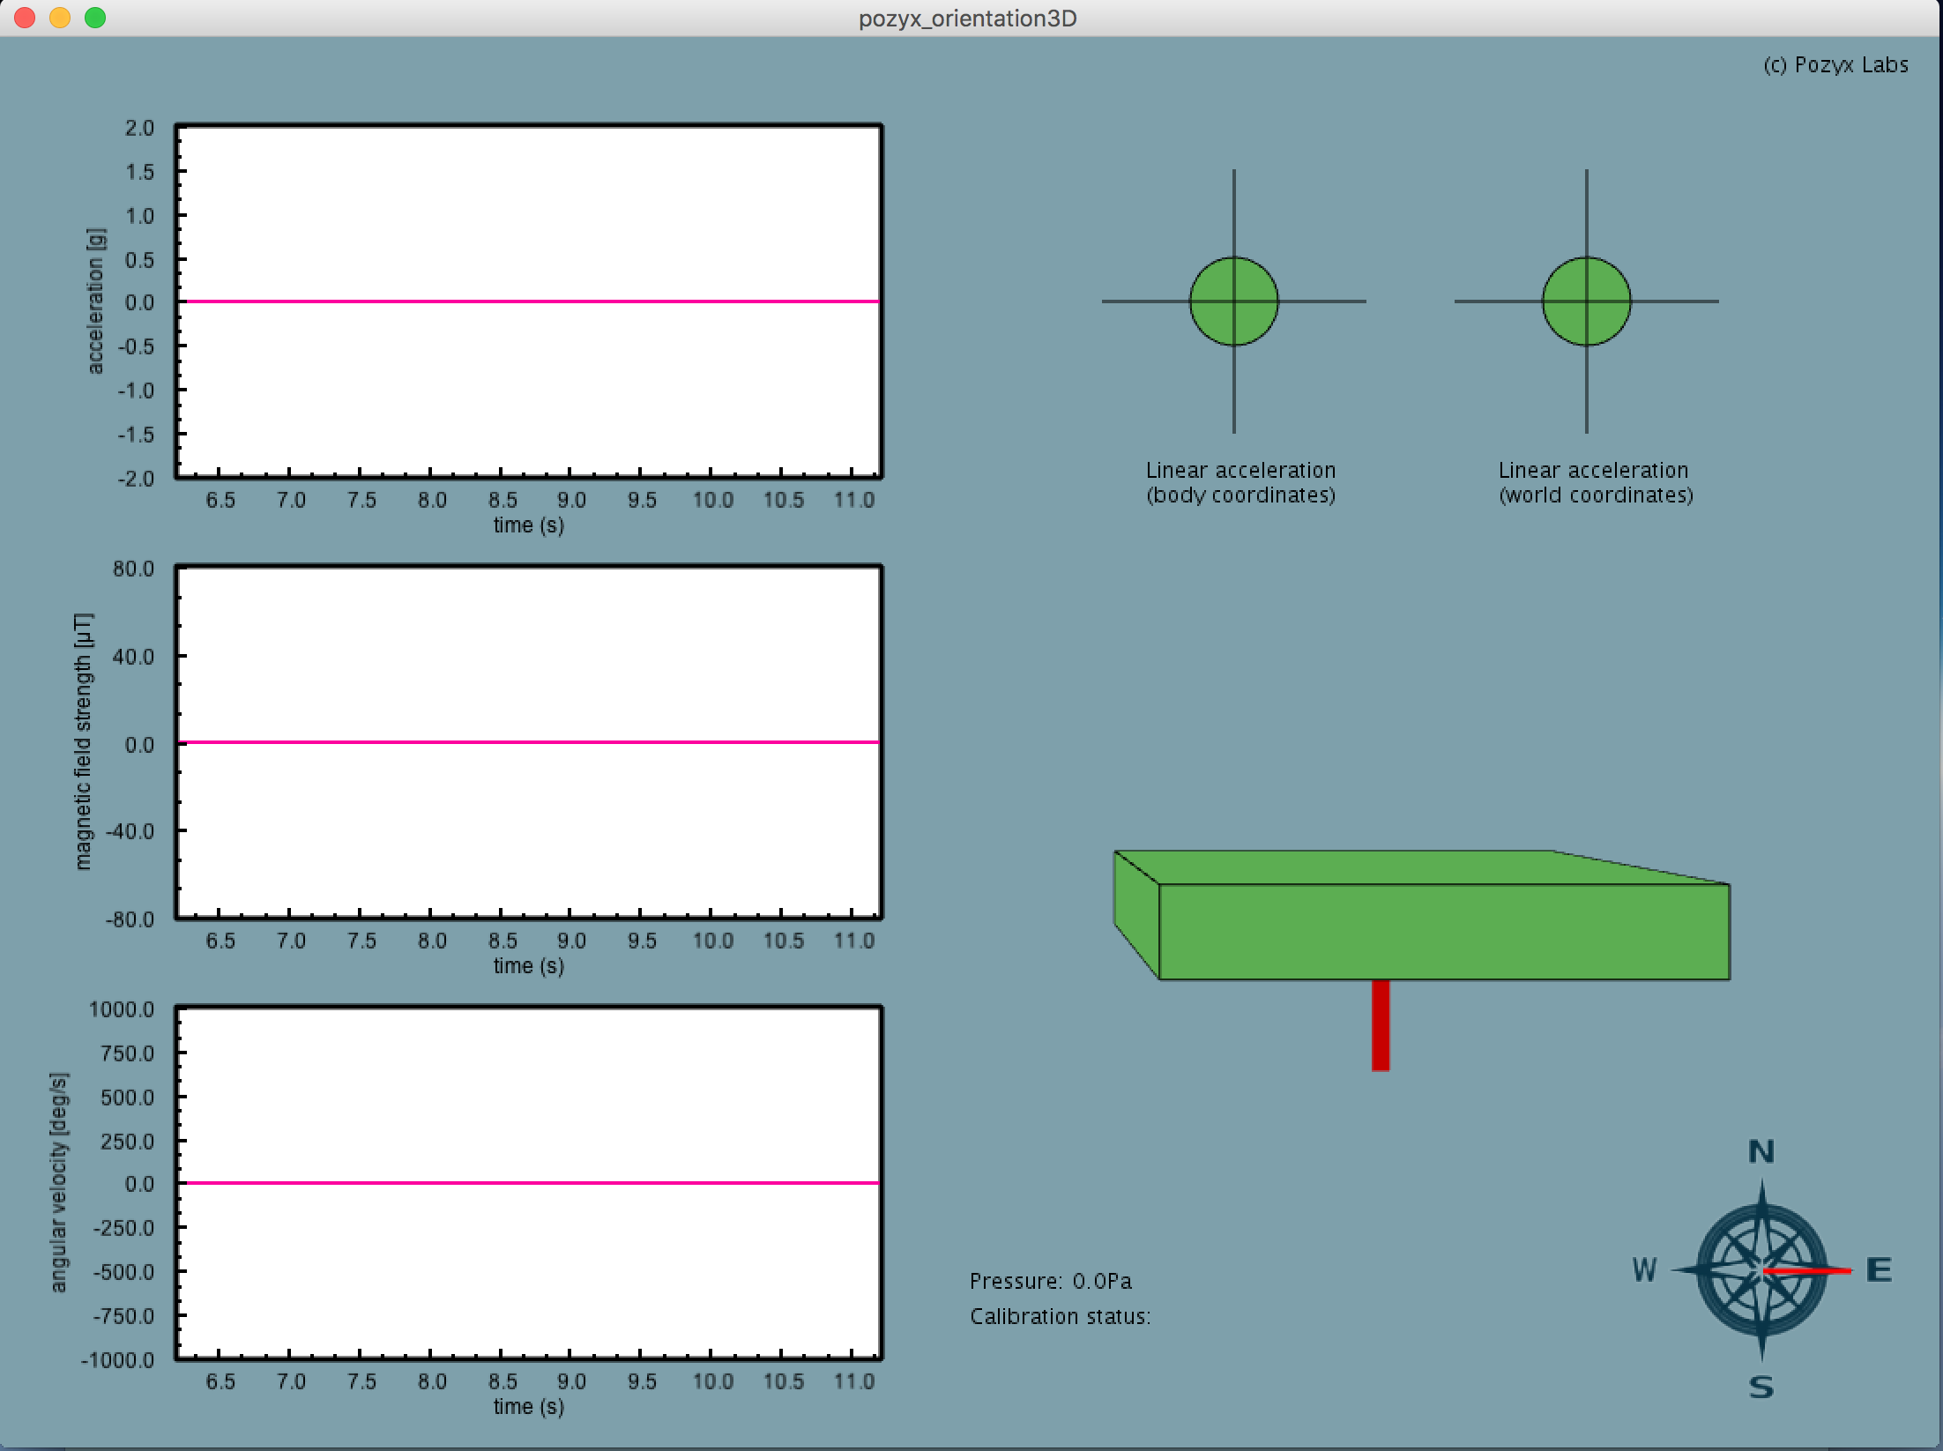
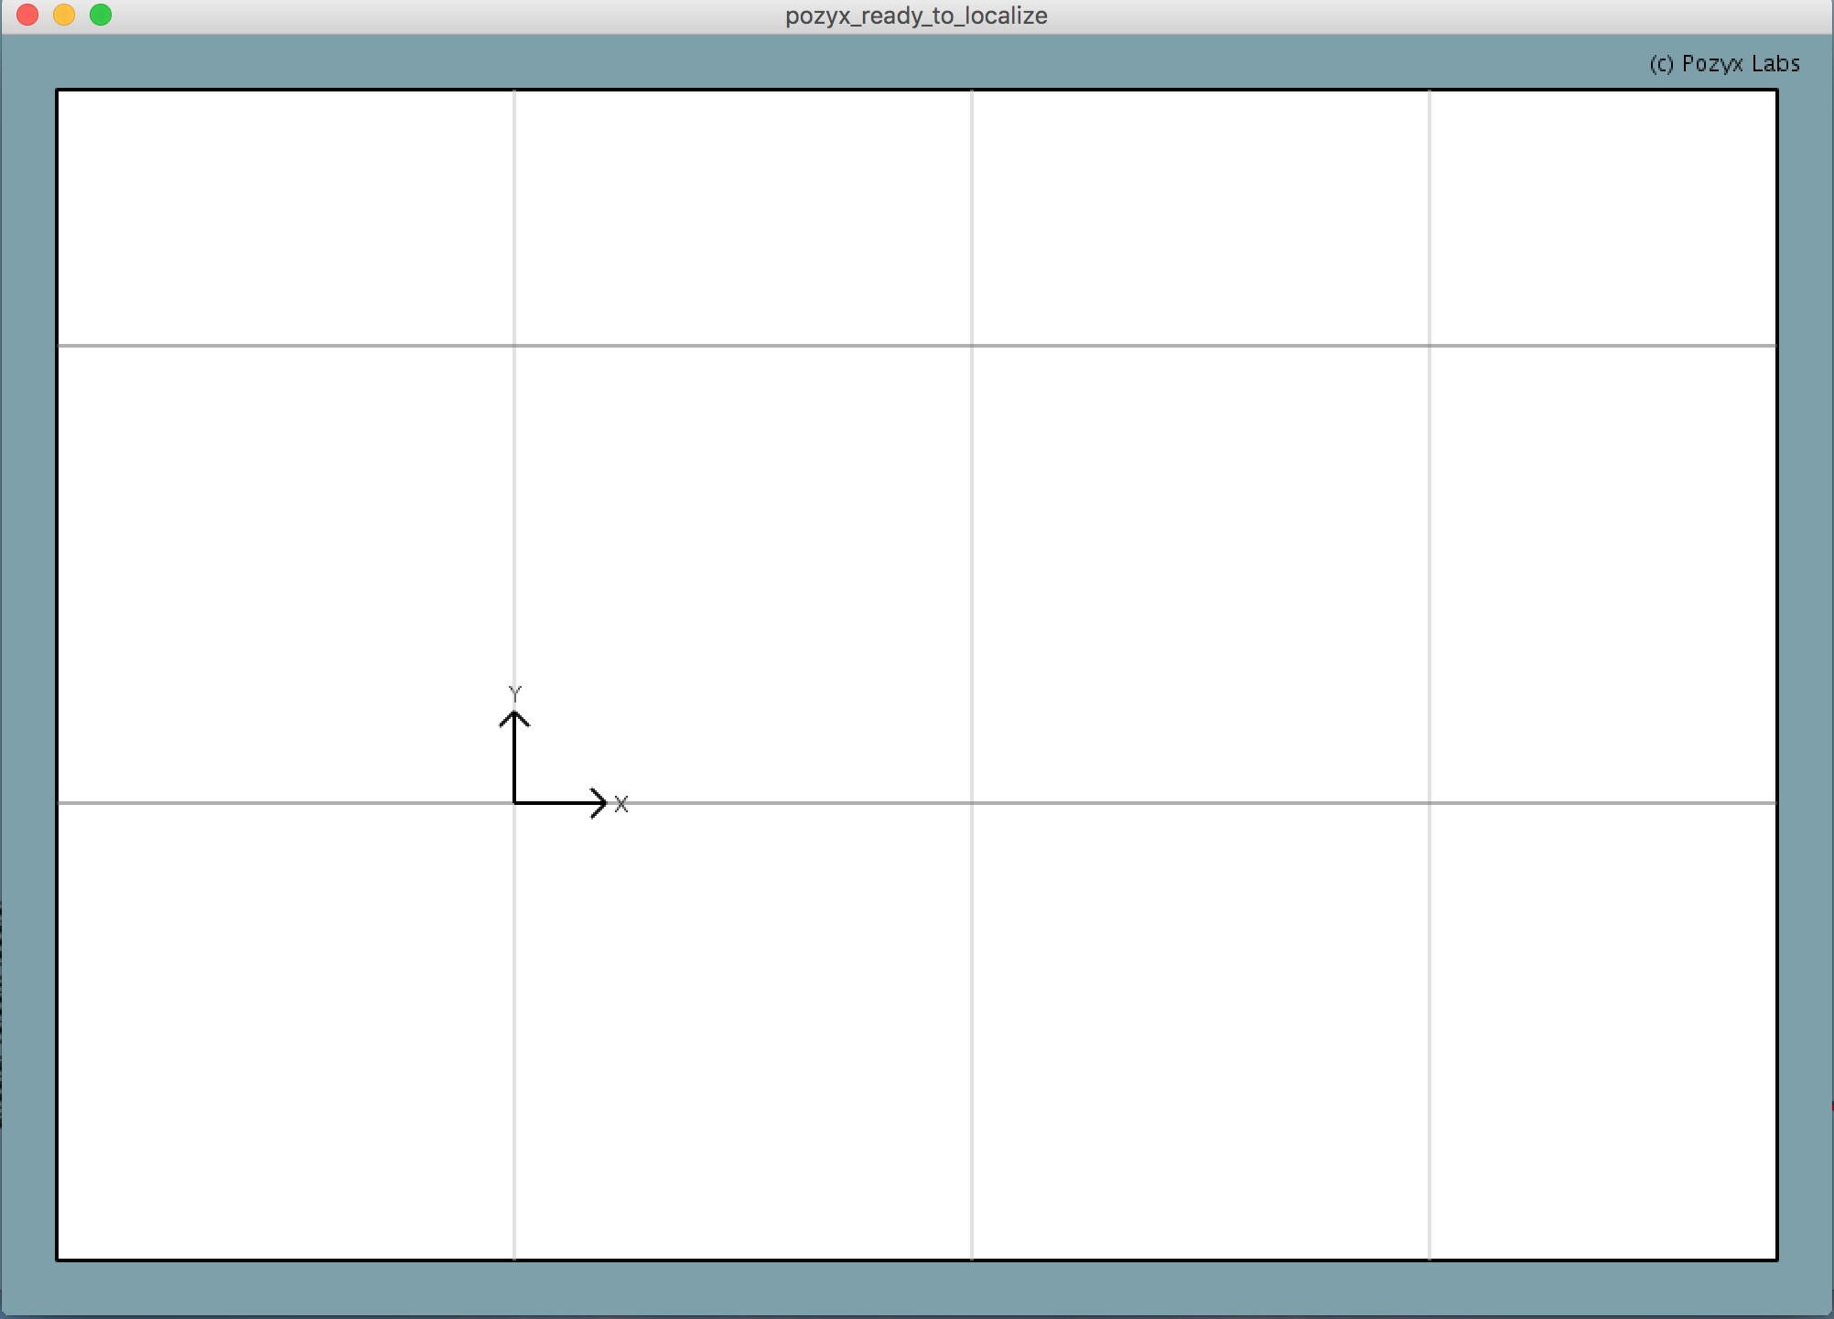
IMPLEMENTATION: iOS APPLICATION
To develop the GUI we have used an IDE called Processing to communicate with the Pozyx localization IC chip.
This will communicate with Pozyx system to collect positional and motion data that could be seen from the application if need be.
This is the scheme for the main portion of the application.
Display 2D location of a Pozyx tracking chip in 2D space live
Uses data collected via the anchors and previous GUI to do this
Intend to under-lay an image of the hospital wing and create virtual boundaries.

Slide 8
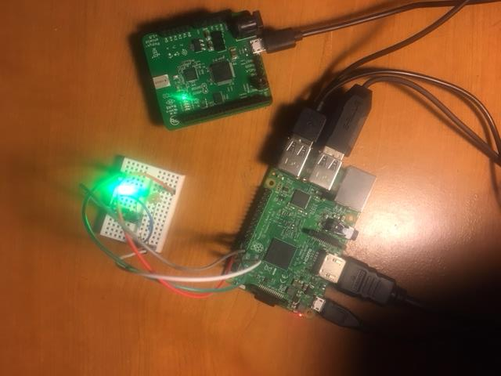
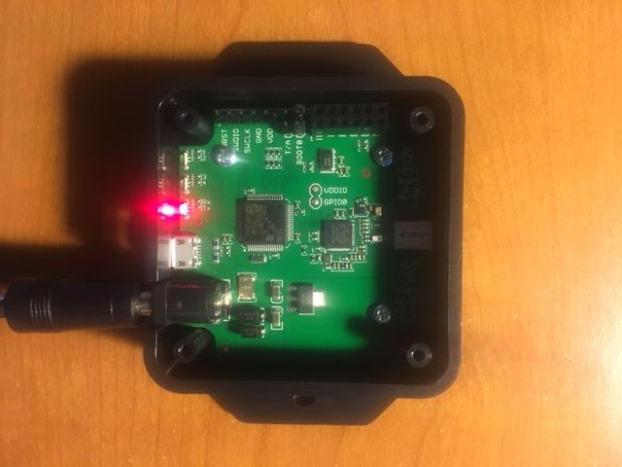
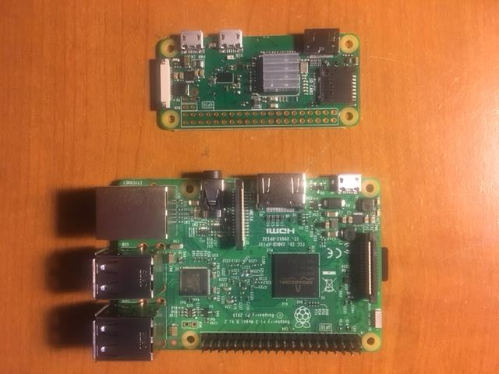
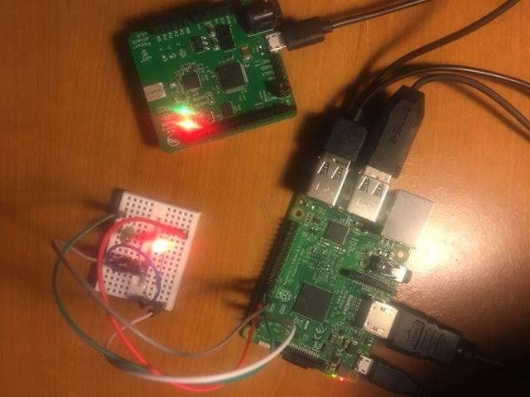
IMPLEMENTATION: HARDWARE

Slide 9
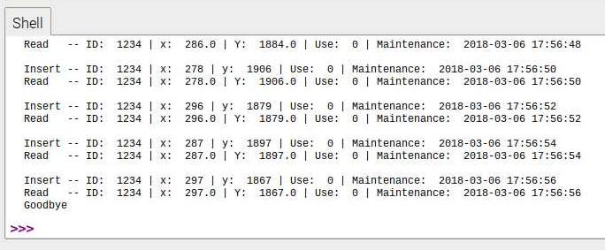
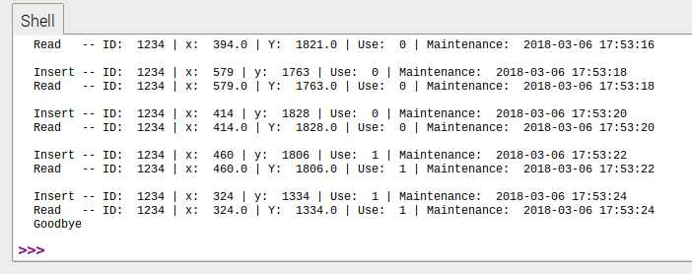
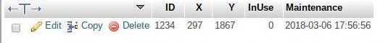
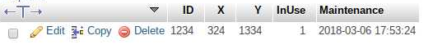
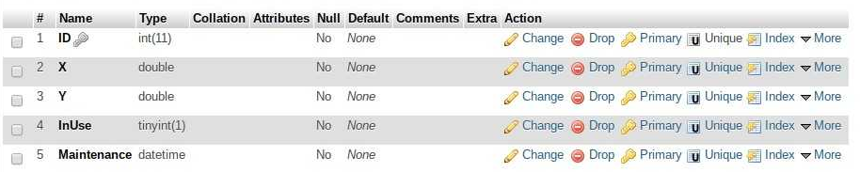
IMPLEMENTATION: SCRIPT & DATABASE

Slide 10
CONCLUSION
Problems: None (so far)
Work Remaining:
Connect local Raspberry Pi DB to google cloud
Incorporate rechargeable battery life into script file and DB
Update tracked ventilator maintenance time
Create login for iOS Application
Pull data from google cloud into iOS Application
Transfer script file and software from Raspberry Pi 3 to Raspberry Pi Zero
Design Map of hospital wing for iOS application and update Pozyx anchor coordinates in script file
Solder button and LEDs to Raspberry Pi Zero
Design and 3D print a case for Tracker

Slide 11
Questions?
11

